Slide 1

How Do You Know When
Your Programs Really Work?
Evaluation Essentials for Program Managers
Session 1: EVALUATION BASICS
Anita M. Baker, Ed.D.
Evaluation Services
Hartford Foundation for Public Giving,
Nonprofit Support Program: BEC
Bruner Foundation

Slide 2

These materials are for the benefit of any 501c3 organization. They MAY be used in whole or in part provided that credit is given to the Bruner Foundation.
They may NOT be sold or redistributed in whole or part for a profit.
Copyright © by the Bruner Foundation 2012
* Please see supplementary materials for a sample agenda, activities and handouts
Bruner Foundation
Rochester, New York

Slide 3
How to Use the Bruner Foundation Evaluation Essentials for Program Managers Powerpoint Slides
The Evaluation Essentials for Program Managers slides were developed as part of a Bruner Foundation special project, by evaluation trainer Anita Baker – Evaluation Services, and jointly sponsored by the Hartford Foundation for Public Giving. They were tested initially with a single organization in Rochester, NY (Lifespan) as part of the Evaluation Support Project 2010. The materials were revised and re-tested with three nonprofit organizations as part of the Anchoring Evaluation project in 2011-12. The slides, intended for use in organizations that have already participated in comprehensive evaluation training, include key basic information about evaluation planning, data collection and analysis in three separate presentations. Organization officials or evaluation professionals working with nonprofit organization managers are encouraged to review the slides, modify order and add/remove content according to training needs. (Please note that the first session begins with a presentation of “results” as a framework to help trainees see the overall relevance of evaluative capacity, i.e., what they are working toward. There is an ancillary file with multiple slides of “results” which can be substituted depending on trainee organization program focus.)
Additional Materials
To supplement these slides there are sample agendas, supporting materials for activities, and other handouts. There are “placeholder” slides with just a picture of the target with an arrow in the bullseye that signify places where activities can be undertaken. Be sure to move or eliminate these depending on the planned agenda.Other more detailed versions of the Evaluation Essentials materials area also available in Participatory Evaluation Essentials: An Updated Guide for Nonprofit Organizations and Their Evaluation Partners and the accompanying 6-session slide presentation. These materials are also available on the Bruner Foundation and Evaluation Services websites free of charge.
Whether you are an organization leader or an evaluation professional working to assist nonprofit organization staff, we hope that the materials provided here will support your efforts.
When you have finished using the Evaluation Essentials for Program Managers series have trainees take our survey. https://www.surveymonkey.com/s/EvalAnchoringSurvey
Bruner Foundation
Rochester, New York

Slide 4
What if you saw results like these?

Slide 5
Or results like these?
More than 90% of case managers at all sites but location C indicated they had fully adopted the Program model (PM).
Two-thirds or more of clients at all sites but location C reported improved quality of life.
SITE | % of clients reporting improved quality of life since PM initiated.
A | 69%
B | 73%
C | 40%
D | 71%
E | 66%

Slide 6
Or these?

Slide 7
What if you saw results like these?
 | RESULTS
Desired Outcome | 2009 | 2010
* 65% of Clients show slowed or prevented disease progression at 6 and 12 months | 83% | 87%
* 75% of clients are fully engaged in HIV primary medical care | 96% | 96%
* 80% of clients show progress in 2 or more areas of service plan | 90% | 94%
* 50% of clients with mental health issues show improvement in mental health function by 6 months | 97% | 97%
* 75% of clients enrolled in SA treatment decrease use of drugs/alcohol after accessing services | 93% | 92%
* 90% of clients show improved or maintained oral health at 6 and 12 months | 92% | 94%

Slide 8

Logical Considerations for Planning
Think about the results you want.
Decide what strategies will help you achieve those results?
Think about what inputs you need to conduct the desired strategies.
Specify outcomes, identify indicators and targets.**
DECIDE IN ADVANCE,
HOW GOOD IS GOOD ENOUGH
5. Document how services are delivered.
6. Evaluate actual results (outcomes).

Slide 9
Outcomes and Indicators
  Changes in behavior, skills, knowledge, attitudes, condition or status.
  Specific, measurable characteristics or changes that represent achievement of an outcome.

Slide 10
Indicator: Reminders
  Many outcomes have more than one indicator
  Identify the set of indicators that accurately signal achievement of an outcome (get stakeholder input)

Slide 11
Targets
  Specify the amount or level of outcome attainment expected, hoped for or required.
  Targets can be set. . . .
  Relative to external standards (when available)
  Past performance/similar programs
  Professional hunches

Slide 12
Target: Reminders
  Should be specified in advance. Requires buy in.
  Carefully word targets so they are not over or under-ambitious, make sense, and are in sync with time frames.
  If target indicates change in magnitude – be sure to specify initial levels and what is positive.

Slide 13
Outcome, Indicator, Target - EXAMPLE
Outcome
Participants will be actively involved in afterschool activities
Indicators
At least 500 students will participate each month.
Students will attend 70% or more of all available sessions.
At least half of participants will participate in 100 or more hours per semester.

Slide 14
Outcome, Indicator, Target - EXAMPLE
Outcome
Participants will learn important skills
Indicators
75% of campers’ parents will report their child learned something new at camp.
Two-thirds of campers enrolled in swimming will demonstrate competency in 3 basic strokes.
Most campers (85%) will demonstrate mastery of all performance dance moves.

Slide 15
Outcome, indicator, target - EXAMPLE
Outcome | Indicators
65% of clients show slowed or prevented disease progression at 6 and 12 months | Sustained CD4 counts within 50 cells
 | Viral loads <5000
50% of clients with MH issues show improvement at 3 months, by 6 months or at program end. | Maintaining or decreasing mental health distress symptoms from baseline to follow-up using SDS

Slide 16
Indicator Examples with Time References
Outcomes | Indicators
Initial: Teens are knowledgeable of prenatal nutrition and health guidelines | Program participants are able to identify food items that are good sources of major dietary requirements
Intermediate: Teens follow proper nutrition and health guidelines | Participants are within proper ranges for prenatal weight gain Participants abstain from smoking Participants take prenatal vitamins
Longer Term: Teens deliver healthy babies | Newborns weigh at least 5.5 pounds and score 7 or above on the APGAR scale.

Slide 17
Outcomes, indicators and targets activity

Slide 18
How do you know when your programs really work? . . . . EVALUATION
Program Evaluation
Thoughtful, systematic collection and analysis of information about activities, characteristics, and outcomes of programs, for use by specific people, to reduce uncertainties, inform decisions.

Slide 19
How do you know when your programs really work? . . . . EVALUATION
Program Evaluation
Thoughtful, systematic collection and analysis of information

Slide 20
How do you know when your programs really work? . . . . EVALUATION
Program Evaluation
Thoughtful, systematic collection and analysis of information about activities, characteristics, and outcomes of programs,

Slide 21
How do you know when your programs really work? . . . . EVALUATION
Program Evaluation
Thoughtful, systematic collection and analysis of information about activities, characteristics, and outcomes of programs, for use by specific people, to reduce uncertainties, inform decisions.

Slide 22
What do you need to do to conduct Evaluation?
Specify key questions
Specify an approach
(develop an evaluation design)
Apply evaluation logic
Collect and analyze data
Summarize and share findings

Slide 23
Key Questions
Focus and drive the evaluation.
Should be carefully specified and agreed upon in advance of other evaluation work.
Generally represent a critical subset of information that is desired.

Slide 24

Evaluation Question Criteria
It is possible to obtain data to address the questions.
There is more than one possible “answer” to the question.
The information to address the questions is wanted and needed.
It is known how resulting information will be used internally (and externally).
The questions are aimed at changeable aspects of activity.

Slide 25
Participants identify questions using criteria

Slide 26
How do you know when your programs really work? . . . . EVALUATION
Program Evaluation
Thoughtful, systematic collection and analysis of information about activities, characteristics, and outcomes of programs, for use by specific people, to reduce uncertainties, inform decisions.

Slide 27
Types, Focuses and Timing of Evaluation
TYPE | FOCUS | TIMING
Monitoring | Compliance with terms of a grant, or program design | Period of the grant or program duration
Formative | Implementation Short/Mid-Term Outcomes | While program is operating While program is operating, at certain key junctures
Summative | Long-term outcomes | As or after the program ends

Slide 28
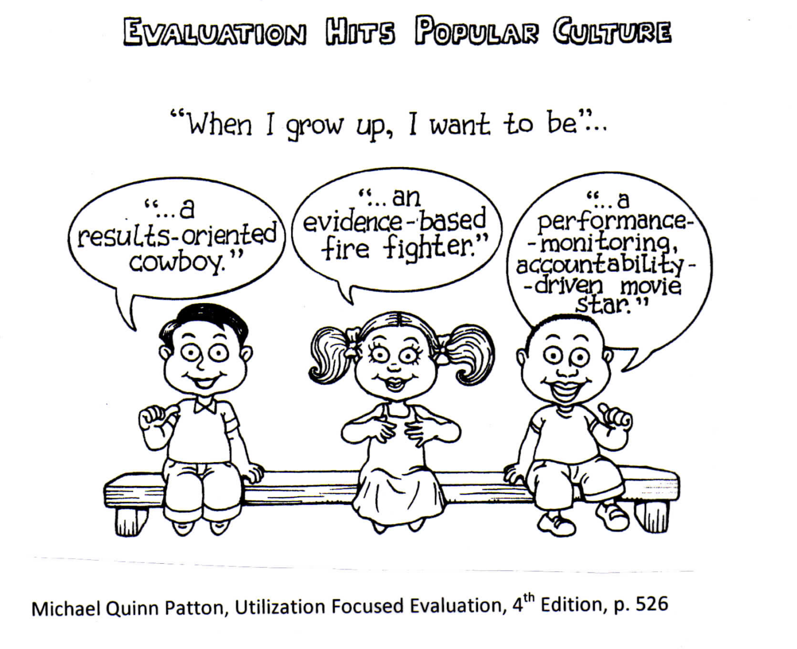
Evaluators

Slide 29
Characteristics of Effective Evaluators
Basic knowledge of substantive area being evaluated
Knowledge about and experience with program evaluation
  Field is un-regulated
  First graduate level training programs in evaluation recent
Good references from sources you trust
Personal style and approach fit (MOST IMPORTANT)

Slide 30
Evaluation Strategy Clarification
◆ All Evaluations Are:
  Partly social
  Partly political
  Partly technical
◆ Both qualitative and quantitative data can be collected and used and both are valuable.
◆ There are multiple ways to address most evaluation needs.
◆ Different evaluation needs call for different designs, data and data collection strategies.

Slide 31
Evaluation Purposes
Evaluations are conducted to:
    Render judgment
    Inform decision-making
    Facilitate improvements
    Generate knowledge
Specify at earliest stages of evaluation planning.
Obtain input from stakeholders.

Slide 32
Who are Evaluation Stakeholders, and Why Do They Matter?
Decision-makers
Information-seekers
Those directly involved with the evaluation subject
Most programs/strategies have multiple stakeholders.
Organization managers, clients and/or their caregivers,
program staff, program funders, partner organizations
Stakeholders have diverse, often competing interests related to programs and evaluation.
Certain stakeholders are the primary intended users of evaluation.

